Slide 1
ToxPipe Agentic API Guide
Last Updated: May 14, 2025

Slide 2
Warning: The ToxPipe Agentic API is still in active development, and all features may not work as intended. API functionality and organization may change in future updates.

Slide 3
Availability
Public API Deployment - https://rstudio.niehs.nih.gov/toxpipe-api/
Internal API Deployment - https://rstudio.niehs.nih.gov/toxpipe-api-internal/ (must authenticate with Posit Connect to use)
API GitHub repository - https://github.com/NIEHS/ToxPipe (must be a member of NIEHS GitHub to access)

Slide 4
Version Differences
Internal
Accessed & used the same way as the public version. The below NIEHS-only tools are accessible automatically when using the internal version.
FunctionalSimilarity - Given a DSSTox Substance ID as input, returns a list of functionally similar chemicals and their corresponding similarities to the input chemical from the ChemBioTox database. Similarities are calculated by cosine distance with distances closer to zero being more similar. Function is based off of predictive models and may not accurately represent the behavior of the chemicals in question.
QueryCBTADMET - Given a DSSTox substance ID or DTXSID as input, annotates a chemical with predicted ADMET QSAR models from the ChemBioTox database. This can be helpful for understanding the absorption, distribution, metabolism, excretion, pathways, transportation, and toxicity of a chemical.
QueryCBTLeadscope - Given a DSSTox substance ID or DTXSID as input, annotates a chemical with predicted Leadscope QSAR models from the ChemBioTox database.
QueryCBTMetabolites - Given a DSSTox substance ID or DTXSID as input, generate metabolites of the chemical from ADMET predictor with corresponding enzymes used in the metabolism.

Slide 5


Usage
Create Agent Handler – To query models, you must first create an agent handler.
Use the /agent/create/ endpoint
Params:
model – Name of AI model to use with agent. A list of supported models is on Slide 6. Important: model name MUST match exactly a name from this list.
temp – Model temperature. Values closer to 1 introduce more variation in responses across model calls (i.e., more stochastic behavior).
max_iterations – The maximum number of agentic steps (“thoughts”) the agent may take. If an agent exceeds this number of steps, it will return with an error.
step_timeout – The maximum time in seconds that an agent may spend on a single step. If an agent exceeds this time, it will return with an error.
n_threads – The number of parallel agents to run for each request to the model. Setting this > 1 will cause the agent handler to spawn n_threads agents that will process the user’s query in parallel. This is best used with temp > 0 to force each agent to formulate a different answer. Each agent’s answer will be included in the final output (the summarize parameter is forced to True). Setting n_threads = 0 disables this feature and just runs a single agent per query.
summarize – This forces the agent to complete an additional query to summarize the results of its thought chain before returning the final answer. Setting this to True may improve the readability of the agent’s responses. This is automatically set to True when n_threads > 1.
Upon successfully creating an agent handler, you will receive a JSON response containing the handler’s unique ID (agentid), as well as the agent options and date/time the handler was created. SAVE THIS INFO – it will only be shown once and cannot be recovered after navigating away! (This behavior may change in a future update).
Use agent handler to query a model
Use the /agent/query/ endpoint
Params:
agentid – Unique ID of an agent handler created in Step 1.
q – Input query for the model.

Slide 6
Supported Models
azure-o3-mini
azure-o3
azure-gpt-4o

Slide 7
Quickstart Example

Slide 8
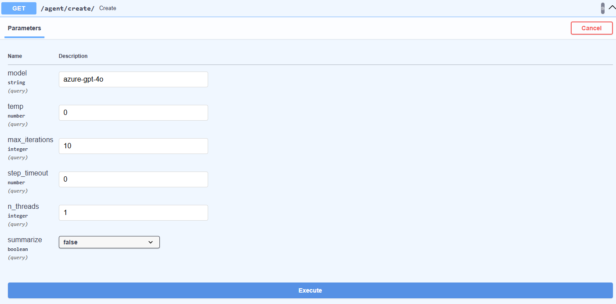
Quickstart - 1
Specify model name from Slide 6. We are using the azure-gpt-4o model here.
Press “Execute” to create the agent handler.

Slide 9
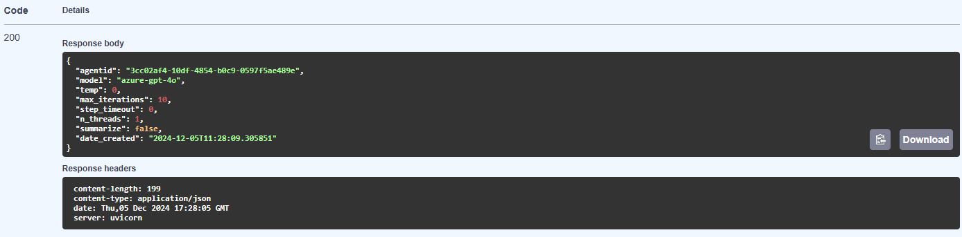
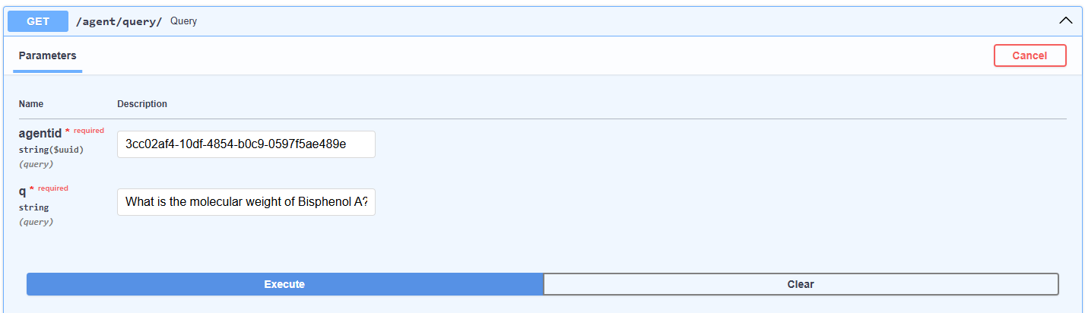
Quickstart - 2
Copy the agentid from the response and copy to the
/agent/query/ endpoint.
This is the query we want to ask the model.
Press “Execute” to submit the query to the agent.

Slide 10
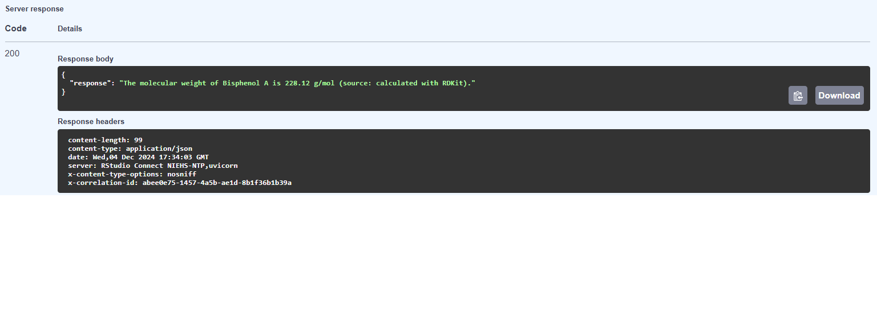
Quickstart - 3
After the agent formulates a response, it will return it as a JSON object.

